Slide 1
Ammonia and Phosphate
in Algonquin Park
Dhrumil Patel, Amy Peng, David Walji, Jenny Wu

Slide 2
1
Introduction

Slide 3
2
Experiments

Slide 4
Procedure
Compare sample colours to scale
5mL of
water for each sample
8 ammonia drops into samples, mix for 5 minutes
8 phosphate drops into samples, mix for 3 minutes
Notes:
Procedure - Data collected using water samples from various bodies of water in Algonquin Park
Each sample station - 2 test tubes each filled with 5 mL of sample water were taken from the given body of water.
6 drops of ammonia 1 and ammonia 2 dripped into their respective water samples - mix with water for 5 minutes
8 drops of phosphate 1 and phosphate 2 dripped into their respective water samples - mix with water for 3 minutes
Water samples colour - compared to colour scale, would determine the ammonia and phosphate levels of each solution

Slide 5
3
Calibrations

Slide 6
Ammonia and phosphate dropper bottle
Data input
Sources of Uncertainty
Notes:
Human error
Accuracy
The
System accuracy
Computer may not have taken the value from the colour scale accurately

Slide 7
4
Data

Slide 8
Ammonia and Phosphate Observations
Substance/ppm | Mean | Standard Deviations | Median
Ammonia | 1.797 | 1.33 | 1.44
Phosphate | 2.503 | 2.949 | 1.33

Slide 9
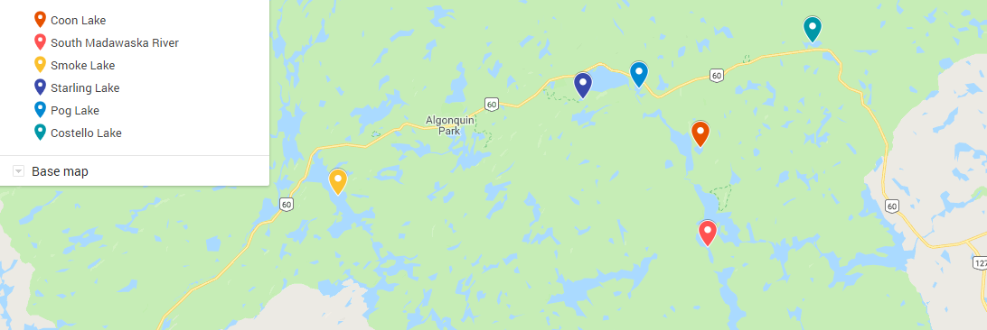
Highway Relations
6 stations
Group 1: 3 stations, 2+ km
Coon, Madawaska, Smoke
Group 2: 3 stations, 2- km
Starling, Pog, Costello

Slide 10
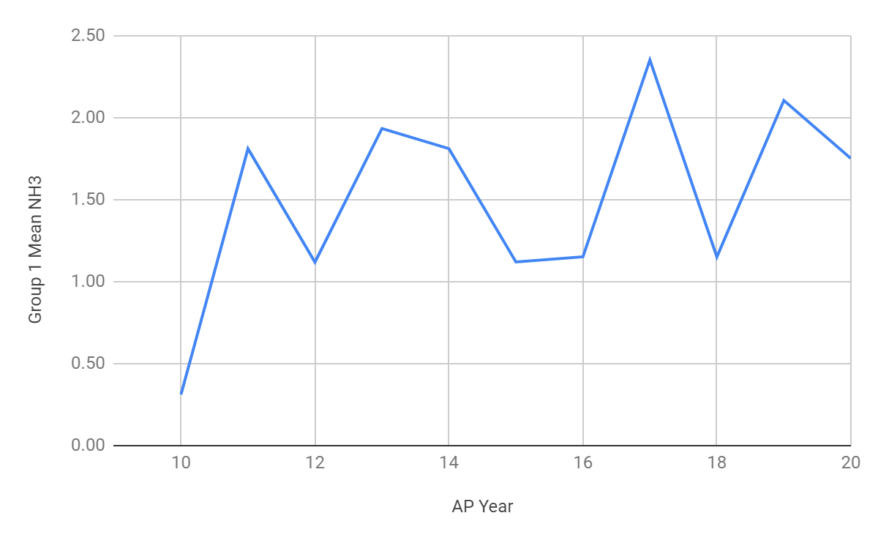
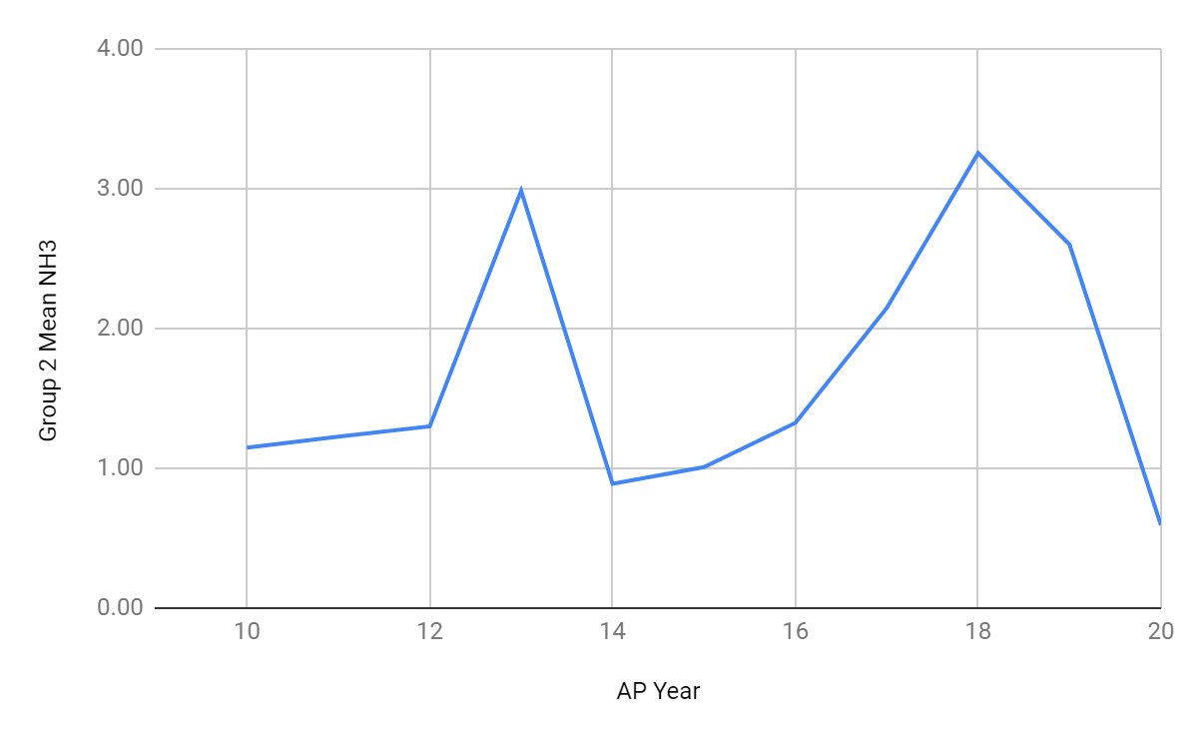
Group Mean Ammonia
Group 1 Mean NH₃ vs AP Year
Group 2 Mean NH₃ vs AP Year

Slide 11
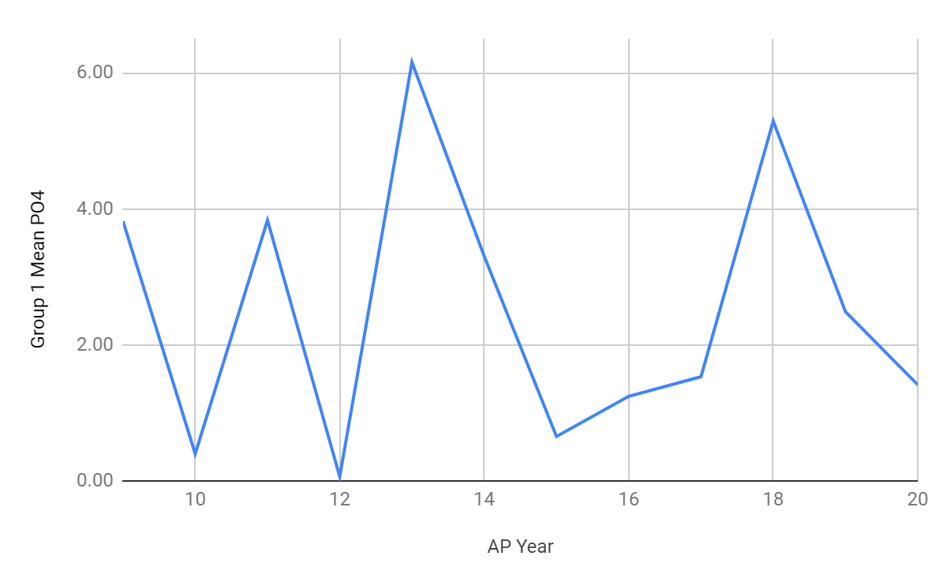
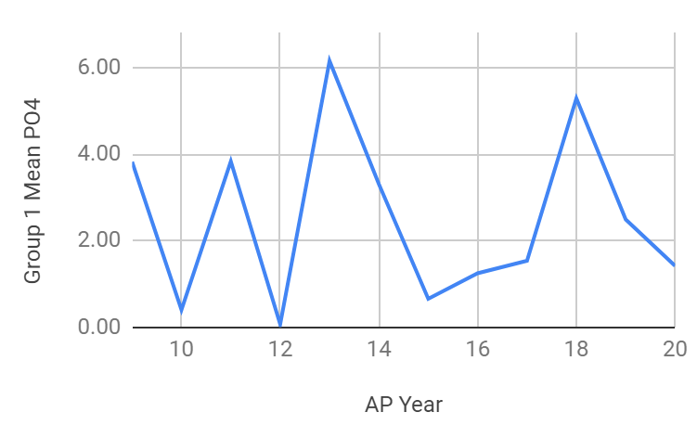
Group Mean Phosphate
Group 1 Mean PO₄³⁻ vs AP Year
Group 2 Mean PO₄³⁻ vs AP Year

Slide 12
5
Trends

Slide 13
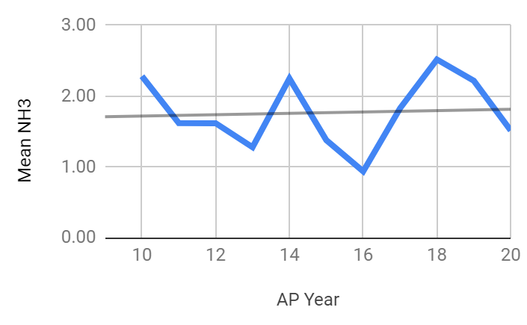
Ammonia
Mean NH₃ vs AP Year
Weak positive correlation
Correlation: 0.06
Determination: 0.4%
Growth rate: 9.51*10⁻³ ppm
AP 14 - AP 16
AP 16 - AP 18

Slide 14
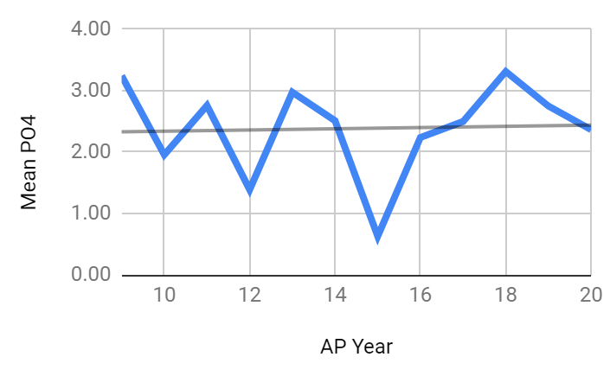
Phosphate
Mean PO₄³⁻ vs AP Year
Weak positive correlation
Correlation: 0.04
Determination: 0.2%
Outlier in AP 15
Growth rate: 9.78*10⁻³ ppm

Slide 15
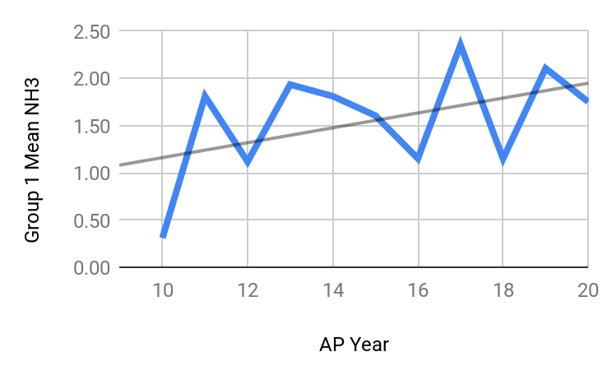
Group 1 Ammonia
Mean NH₃ vs AP Year
Strong Positive Association
Correlation: 0.44
Determination: 19%
Growth rate: 0.09 ppm

Slide 16
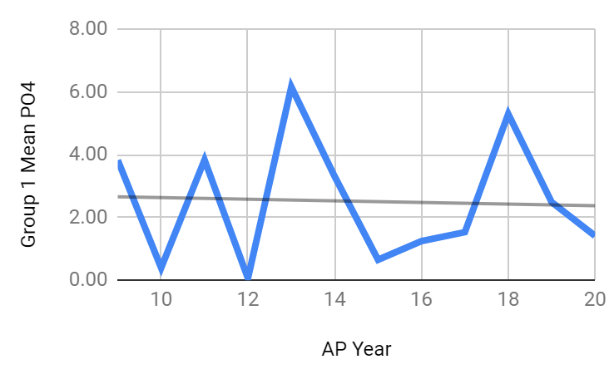
Group 1 Phosphate
Mean PO₄³⁻ vs AP Year
Weak Negative Association
Correlation: - 0.04
Determination: 0.2%
Growth rate: - 0.03 ppm

Slide 17
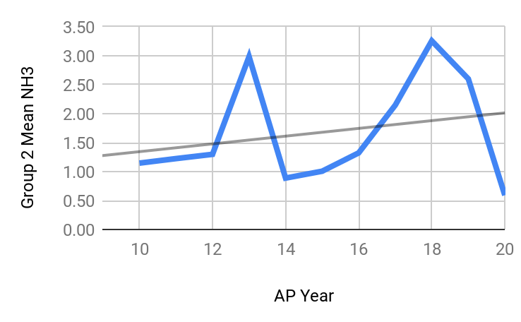
Group 2 Ammonia
Mean NH₃ vs AP Year
Moderate Positive Association
Correlation: 0.24
Determination: 5.9%
Growth Rate = 0.07 ppm

Slide 18
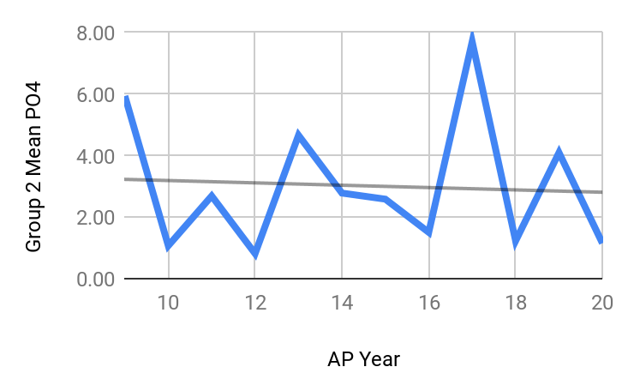
Group 2 Phosphate
Mean PO₄³⁻ vs AP Year
Weak Negative Association
Correlation: - 0.06
Determination: 0.4%
Growth rate: - 0.04 ppm
Notes:
Figure 6 depicts the mean phosphate concentrations of the chosen sample stations that were less than 2 kilometers away from highway 60. As shown in
Group 2 had a greater mean phosphate concentration than Group 1, Group 2 had a mean phosphate concentration of 3.02 ppm while Group 1 had a mean ammonia concentration of 2.52 ppm, suggesting that a lower distance from human activity is associated with higher phosphate concentrations and a greater distance from human activity is associated with lower phosphate concentrations. Moreover, the rate at which the phosphate concentration is predicted to decrease is higher in Group 2 than in Group 1, as it was predicted that mean phosphate concentration would increase, each year, by 0.04 ppm in Group 2, but by only 0.03 ppm in Group 1, suggesting that a lower distance from human activity is associated with a higher rate of mean phosphate concentration decreases. The strength of the correlation, given by the coefficients of correlation and determination also supported the association between a lower distance from human activity and a higher rate of mean phosphate concentration decreases.

Slide 19
Group 1
Mean NH₃: 1.51 ppm
NH₃ Growth Rate: 0.09 ppm
Group 2
Mean NH₃: 1.68 ppm
NH₃ Growth Rate: 0.07 ppm
Highway Ammonia Associations
Notes:
Group 1 - more than 2 km from highway 60
Group 2 - less than 2 km from highway 60

Slide 20
Group 1
Mean PO₄³⁻: 2.52 ppm
PO₄³⁻ Growth Rate: - 0.03 ppm
Group 2
Mean PO₄³⁻: 3.02 ppm
PO₄³⁻ Growth Rate: - 0.04 ppm
Highway
Phosphate Associations
Notes:
Group 1 - more than 2 km from highway 60
Group 2 - less than 2 km from highway 60

Slide 21
6
Implications

Slide 22
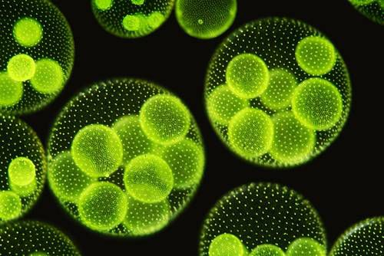
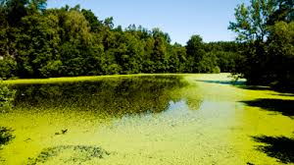
Algae and Eutrophication
Correlated to +nutrient, +O
DO levels rise by 0.55ppm
Habitability decrease
Eutrophication → low dissolved oxygen contents
Suggests strong positive correlation

Slide 23
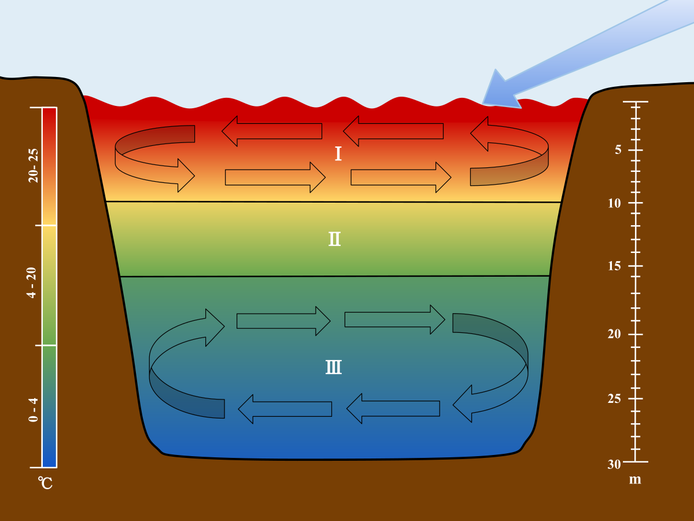
Anoxic Hypolimnion
General decrease in DO in water
Fish at top of food web - thermally sensitive
Increase in temperature - area inhabitable
Anoxic hypolimnion - caused by low DO levels with limited sunlight
Temperature levels in bodies of water

Slide 24
Excess in ammonia levels
Necessary nutrient
Overabundance
Alteration in metabolism
An increase in body pH
Ammonia

Slide 25
Future
Research
7

Slide 26
Lack of specificity of the correlation between ammonia and phosphate concentrations
Simpson’s Paradox
Distance of a sample station from concentrated human activity
Future Research

Slide 27
Questions?

Slide 28
Sources
8
Algonquin Science Expeditions. (May 2017). Marc Garneau Collegiate Institute, Henri M. van Bemmel [PDF File]. Retrieved May 25, 2019, from http://www.hmvb.org/AP18TM.pdf
Ammonia. (n.d.). Retrieved May 27, 2019, from
https://apps.sepa.org.uk/spripa/Pages/SubstanceInformation.aspx?pid=1
Ammonia Uses and Benefits | Chemical Safety Facts. (2019, January 02). Retrieved May 27, 2019, from https://www.chemicalsafetyfacts.org/ammonia/
Aquatic Life Criteria - Ammonia. (2019, March 13). Retrieved May 28, 2019, from https://www.epa.gov/wqc/aquatic-life-criteria-ammonia#how
Background Information for Interpreting Water Quality Monitoring Results. (n.d.). Delaware, Adopt-A-Wetland, [PDF File], Retrieved May 25, 2019, from http://www.dnrec.delaware.gov/fw/Education/Documents/AREC/Water%20quality%20interpretation%20guides.pdf
Eutrophication and Water Pollution. (2018, September 29). Retrieved May 28, 2019, from https://www.water-pollution.org.uk/eutrophication-and-water-pollution/
Louis, J. L. (2018, September). Overview of Phosphate's Role in the Body - Hormonal and Metabolic Disorders. Retrieved May 28, 2019, from https://www.merckmanuals.com/home/hormonal-and-metabolic-disorders/electrolyte-balance/overview-of-phosphate-s-role-in-the-body
Oram, B. (n.d.). Mr. Brian Oram, PG. Retrieved May 28, 2019, from https://water-research.net/index.php/ammonia-in-groundwater-runoff-and-streams
Oram, B. (n.d.). Mr. Brian Oram, PG. Retrieved May 26, 2019, from https://www.water-research.net/index.php/phosphate-in-water
Phosphate Facts. (n.d.). Retrieved May 24, 2019, from https://phosphatesfacts.org/what-are-phosphates/

